Slide 1
Sentiment Analysis
Let’s Begin !!!

Slide 2
Team Members :
01
02
03
04
20BCY10087 (ASHUTOSH SHUKLA)
20BCY10102
(G. SHARAN RAGHAV)
20BCY10176 (CH. SAI MANEESH)
20BCY10186
(B. SHIVA SAI)
Honourable Guide :
DR. ASHISH RANJAN SIR

Slide 3
Introduction To Sentiment Analysis :
Sentiment = feelings
– Attitudes
– Emotions
– Opinions
Subjective impressions, not facts
Generally, a binary opposition in opinions is assumed
For/against, like/dislike, good/bad, etc.
Some sentiment analysis jargon:
– “Semantic orientation”
– “Polarity”

Slide 4
Existing Work With Limitations :
Sentiment analysis tools can identify and analyze many pieces of text automatically and quickly.
But computer programs have problems recognizing things like sarcasm and irony, negations, jokes, and exaggerations - the sorts of things a person would have little trouble identifying. And failing to recognize these can skew the results.
'Disappointed' may be classified as a negative word for the purposes of sentiment analysis, but within the phrase “I wasn't disappointed", it should be classified as positive.
Analyzing natural language data is, in my opinion, the problem of the next 2-3 decades.
It’s imperative to have a sufficiently sophisticated and rigorous enough approach that relevant context can be taken into account.
For example, that would require knowing that a particular user is generally sarcastic, ironic, or hyperbolic, or having a larger sample of the natural language data that provides clues to determine whether or not a phrase is ironic.”

Slide 5
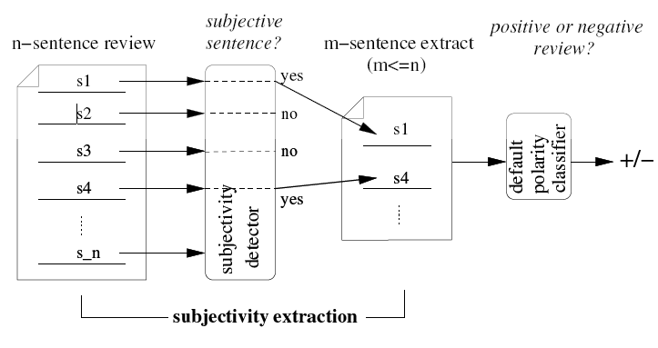
Proposed Work And Methodology :
Aim : To extract subjective portions of text
Algorithm used : Minimum cut algorithm
'Disappointed' may be classified as a negative word for the purposes of sentiment analysis, but within the phrase “I wasn't disappointed", it should be classified as positive.
Proposed algorithms enhancements, Transfer learning, emotion detection, and building resources to improve the errors

Slide 6
Novelty Of The Project :
The Sentiment analysis recognizes the polarity of opinion and emotion attributes regarding the Stock News.
The Subjectivity strongly depends on its sentences or messages.
The Novelty of lexicon and its semantics can be used to distinguish between words and phrases in determining the polarity of the sentiment in stock news.
The Novelty of the proposed method is that the stock news are not simply classified by sentiment polarity but instead generate the grading of sentiment for each selected stock.
Proposed algorithms enhancements, Transfer learning, emotion detection, and building resources to improve the errors.
In the Previous study, the problem of classification deals with traditional statistical and probability distribution for scaling the polarity and chances of errors are more

Slide 7
Real Time Usage :
Investing in the Stock Market is a great way of tackling Inflation.
Inflation refers to the rise in the prices of most goods and services of daily or common use, such as food, clothing, housing, recreation, transport, consumer staples, etc.
In the pandemic-struck financial year of 2020–2021 a whopping 142 lakh new investors have started trading in the stock market.
One key skill required to make good investments in the stock market is being able to correctly analyze news related to the finance and the business sector.
The People can predict the stock using sentiment analysis in stock news

Slide 8
Hardware & Software Requirements :
Software Requirements : Rapidminer, R, Weka, Knime, Python, Vs Code ….etc.
Hardware Requirements : Normal Laptop with decent features.

Slide 9
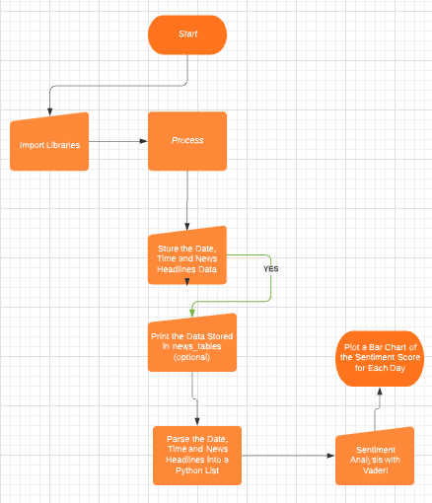
Overall System Architecture Diagram :

Slide 10
Working Model Explanation :
Extract stock sentiments from financial news headlines in FinViz website using Python.
FinViz is definitely one of my favorite go-to websites for information on the stock market. From fundamental ratios, technical indicators to news headlines and insider training data, it is a perfect stock screener. Furthermore, it has updated information on the performance of each sector, industry and any major stock index.
An example of the news headlines section for Amazon (with ticker ‘AMZN’) from the FinViz website is given below. Feel free to visit it and scroll down to this section to see it for yourself! This section is updated live, for every single stock.
Instead of having to go through each headline for every stock you are interested in, we can use Python to parse this website data and perform sentiment analysis (i.e. assign a sentiment score) for each headline before averaging it over a period of time.
The idea is that the averaged value may give valuable information for the overall sentiment of a stock for a given day (or week if you decide to average over a week’s news). What makes it easier to parse the website is that you simply have to add the stock ticker at the end of this url ‘https://finviz.com/quote.ashx?t=’ to parse it (see the url in the image above). Let’s get right down to it!

Slide 11
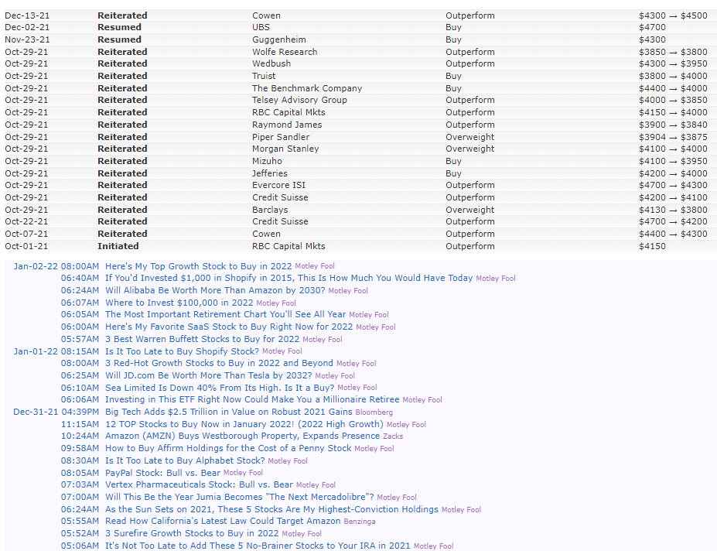
News Section in FinViz page for ‘AMZN’ stock ticker

Slide 12
Working Model Explanation :
1) Import Libraries
First, we import the libraries that we need to store the data. ‘BeautifulSoup’ is needed to parse data from FinViz while ‘requests’ is needed to get data. ‘Pandas’ is used to store the data in DataFrames while ‘Matplotlib’ is used to plot the sentiment on a chart. Finally, the ‘nltk.sentiment.vader’ library is used to perform sentiment analysis on the news headlines!
2) Store the Date, Time and News Headlines Data
Let’s take a closer look at the news headlines for Amazon (AMZN) and its corresponding html code below. You can also visit the FinViz page and view the html code in your browser.
Notice from the above code that all the news is stored into a table with id=“news-table”. I have included two rows of data from the table, bounded by <tr> </tr> tags. The code for one of the rows is boxed up. Note the date and time data between the first <td></td> tags in the box, and the news headline text in the <a></a> tags. We are going to extract the date, time and news headline for each row and perform sentiment analysis on the news headline.
The code below shows stores the entire ‘news-table’ from the FinViz website into a Python dictionary, news_tables, for theses stocks — Amazon (AMZN), Tesla (TSLA) and Google(GOOG) (or rather Alphabet, the company that owns Google). You can include as many tickers as you want in the tickers list.

Slide 13
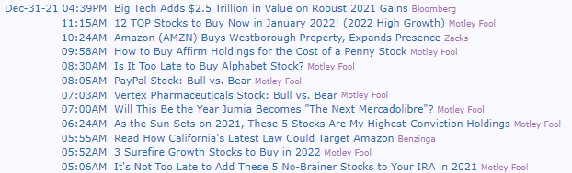
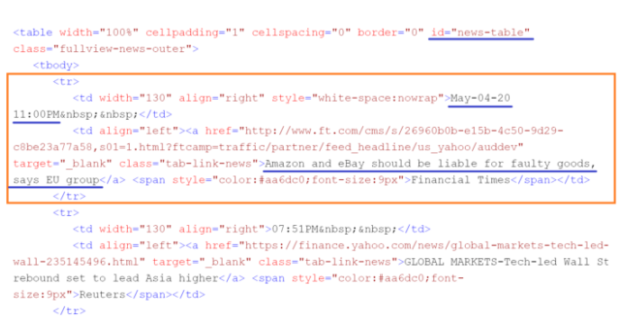

Slide 14
Working Model Explanation :
3) Print the Data Stored in news_tables (optional)
To get a sense of what is stored in the news_tables dictionary for ‘AMZN’. Feel free to run the code below, which iterates through each <tr></tr> tags (for the first 4 rows) to obtain the headlines between the <a></a> tags and the date and time between the <td></td> tags before printing them out. This step is optional and is for your own learning.
You should get something like this below (with more updated headlines of course).
Is It Too Late to Buy Shopify Stock?
Jan-01-22 08:15AM
3 Red-Hot Growth Stocks to Buy in 2022 and Beyond
08:00AM
Will JD.com Be Worth More Than Tesla by 2032?
06:25AM
Sea Limited Is Down 40% From Its High. Is It a Buy?
06:10AM

Slide 15
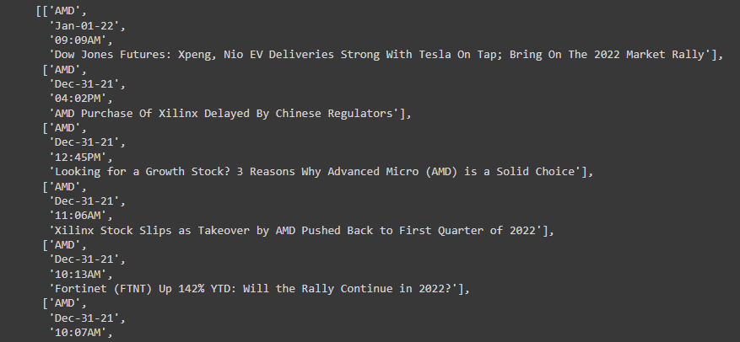
Working Model Explanation :
4) Parse the Date, Time and News Headlines into a Python List
The following code is similar to the one above, but this time it parses the date, time and headlines into a Python list called parsed_news instead of printing it out. The if, else loop is necessary because if you look at the news headlines above, only the first news of each day has the ‘date’ label, the rest of the news only has the ‘time’ label so we have to account for this.
Part of your list from the above code with look like this. Notice that it is actually a list of lists, with each list containing the ticker symbol, date, time and corresponding news-headline.

Slide 16
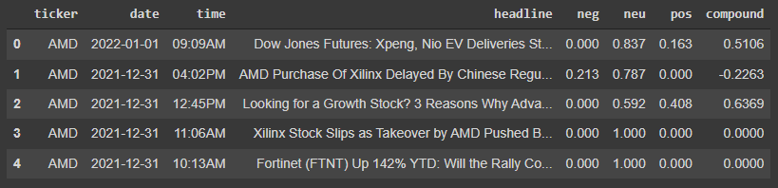
Working Model Explanation :
5) Sentiment Analysis with Vader!
It is now time to perform sentiment analysis with nltk.sentiment.vader, finally! We store the ticker, date, time, headlines in a Pandas DataFrame, perform sentiment analysis on the headlines before adding an additional column in the DataFrame to store the sentiment scores for each headline.
The first 5 rows of the DataFrame from the code above should look something like this. The ‘compound’ column gives the sentiment scores. For positive scores, the higher the value, the more positive the sentiment is. Similarly for negative scores, the more negative the value, the more negative the sentiment is. The scores range from -1 to 1.

Slide 17
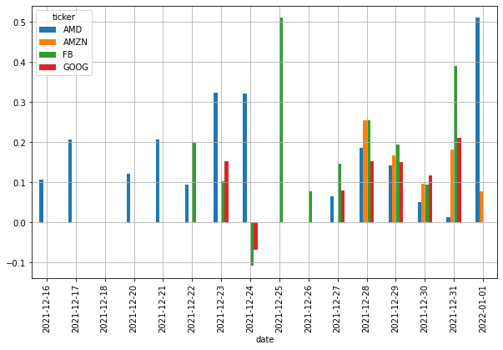
Working Model Explanation :
6) Plot a Bar Chart of the Sentiment Score for Each Day
The following code takes the average of the sentiment scores for all news headlines collected during each date and plots it on a bar chart. You can average the scores for each week too, to obtain the overall sentiment for a week.
The above code gives rise to the following chart. Notice that on some days without news headlines for any particular stock, there would be no sentiment score.

Slide 18
Literature Review :
Sentiment analysis has increasingly received significant research attention.
Opinion mining has emerged as a key tool to comprehend the sentiments of the target audience in order to build superior predictive models.
This section briefly outlines the research on stock prediction techniques.
It summarizes the techniques that only consider numerical financial data for stock prediction.
Then it discusses the feature extraction from textual data.
It also summarizes the prediction algorithms that exploit the combination of numerical and textual data for prediction.
As the prediction of stock market movement has always lured many researchers
as well as practitioners, it has attracted huge attention from researchers.
A study by suggested the utility of data from microblogging sites for predicting behavior and
movement of the stock market where variables such as trading volume, volatility and returns of stock
were taken into consideration.

Slide 19
Module Description :
Sentiment Analysis on Stock News Description :-
Basic description program predicts the company stock price increase or decrease based on news headlines
Import the libraries
Load the data
Store the data into variable
Show the first 3 rows of data for df
Get the number of rows and columns
Print the first 3 rows of data for df2
Get the number of rows and columns
Merge the data set on the date field

Slide 20
Module Description :
Show the merged data set
Combine the top news headlines
print a sample of the combined headlines
Show the combined cleaned headlines
Add the clean headlines to the merge data set & Show the new column
Create a function to get the Subjectivity & Create a function to get the Polarity
Create new columns 'Subjectivity' and 'Polarity’
Create a function to get the sentiment scores

Slide 21
Module Description :
Get the sentiment scores for each day
Store the sentiment scores in the merge data set
Show the merge data
Create a list of columns to keep & Create the feature data set & Create the target data set
Split the data into 80% training and 20% testing data sets
Create and train the model
Show the models predictions
Show the model metrics

Slide 22
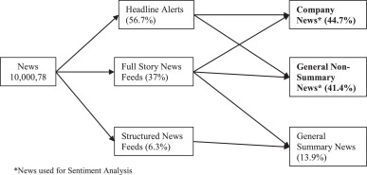
Module Work Flow Explanation :
We predict the price of company stock weather increases or decreases using sentiment analysis
Step-1 is to get the data sets
Step-2 is to import required tools
Step-3 is to mega two data set
Step-4 is to get sentiment scores for each day of mega data set
Step-5 is getting the prediction and accuracy

Slide 23
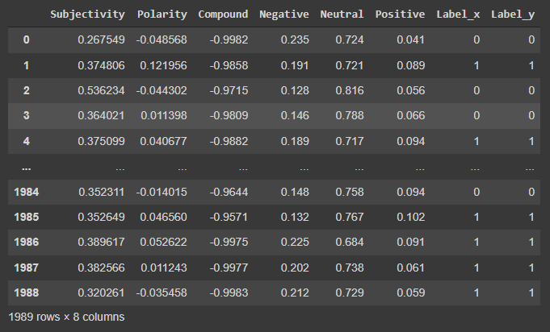
Snap Shot Of Your Project :

Slide 24
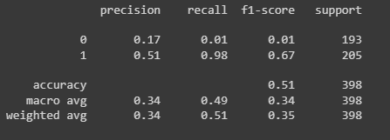
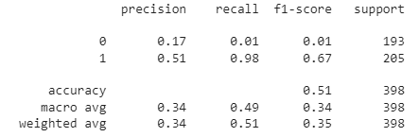
Testing :

Slide 25
Result And Discussion :
We tested the models using different testing options so that we can compare each method against different scenarios.
We would like to extend this research by adding more company’s data and check the prediction accuracy.
For those companies where availability of financial news is a challenge, we would be using twitter data for similar analysis.
We can also incorporate similar strategies for algorithmic trading.
We would like to thank our guides and My friends who supported in the completion of this research project.
Appreciating our guide who helped us knowingly or unknowingly for this project.

Slide 26
Conclusion :
We assumed that news articles and stock price are related to each other.
And, news may have capacity to fluctuate stock trend.
So, we thoroughly studied this relationship and concluded that stock trend can be predicted using news articles and previous price history
As news articles capture sentiment about the current market, we automate this sentiment detection and based on the words in the news articles, we can get an overall news polarity.
If the news is positive, then we can state that this news impact is good in the market, so more chances of stock price go high.
Given any news article, it would be possible for the model to arrive on a polarity which would further predict the stock trend.

Slide 27
Reference :
http://www.cs.cornell.edu/home/llee/papers/cutsent.home.html
https://ars.els-cdn.com/content/image/1-s2.0-S0970389619301569-gr1.jpg
https://www.researchgate.net/profile/Sree-Harissh-Venu/publication/307577577/figure/fig2/AS:401918498230272@1472836245118/Architecture-of-Sentiment-Analysis-phase.png
https://portfolios.cs.earlham.edu/wp-content/uploads/2017/12/Capstone_Submisstion.pdf

Slide 28


Slide 29
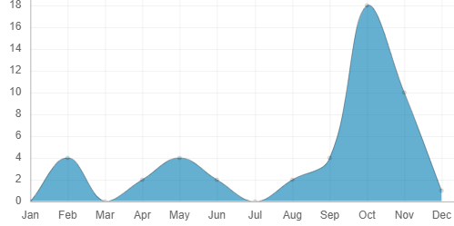
Survey On Sentiment Analysis Of Stock News :

Slide 30
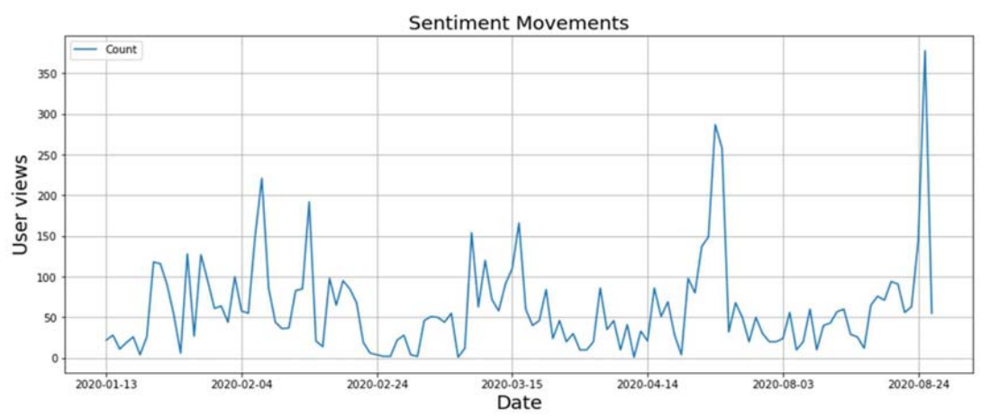
Survey On Sentiment Analysis Of Stock News :

